Slide 1
SUPPLY CHAIN MANAGEMENT PROJECT
By- Reeshav Bhaumik

Slide 2




CONTENT
PROJECT SUMMARY
KPI LIST
EXCEL DASHBOARD
TABLEAU DASHBOARD
POWER BI DASHBOARD
SQL QUERY
KEY TAKEAWAY

Slide 3
SUMMARY ABOUT THE PROJECT
Objective: Analyze supply chain data to improve efficiency, optimize inventory, and enhance decision-making.
Datasets Used: 8 key tables – Customer Data, Countries, Product, Stores, Inventory Adjusted, Point of Sale, Sales, and Supply Chain View.
Inventory plays a crucial role in supply chain management by ensuring the availability of products while minimizing excess stock and shortages.

Slide 4
The project involves creating dashboards in Excel, Tableau, and Power BI, along with SQL queries for deeper data insights.
Tools Used: Excel, Tableau, Power BI, and SQL for data analysis and visualization.
SQL Queries: Used to extract key insights and perform data manipulation.
Key Outcome: Helps in trend analysis, demand forecasting, cost reduction, and better supply chain decision-making.

Slide 5
KPI & TABLE LIST
MTD, YTD & QTD
PRODUCT WISE SALE
YOY GROWTH BY PERCENTAGE
DAILY SALES TREND
STATE WISE SALE
TOP 5 REGION WISE SALE
PURCHASE METHOD
INVENTORY HEALTH
TOP AND BOTTOM 10 PRODUCT

Slide 6
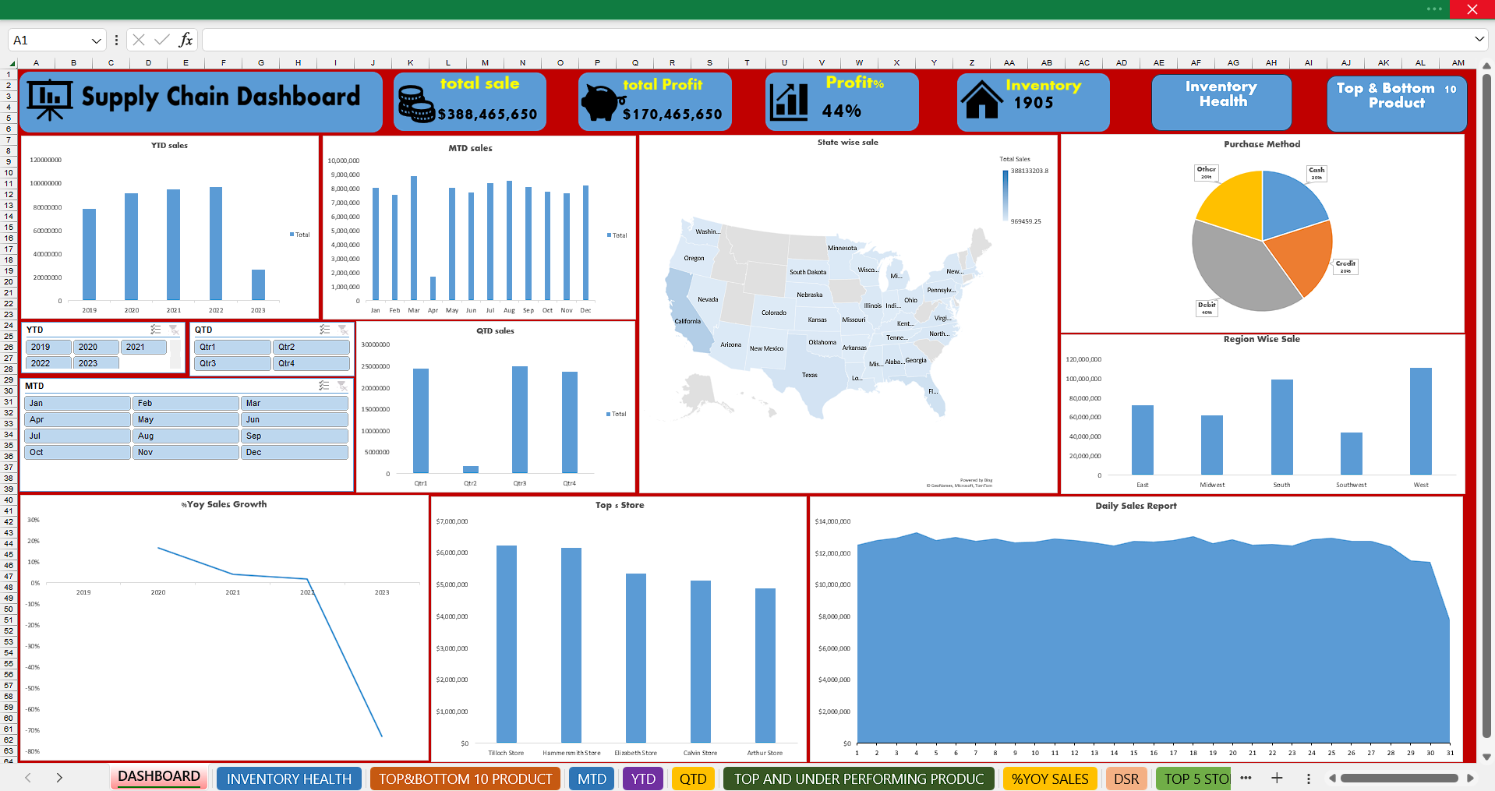
EXCEL DASHBOARD
NAVIGATION BUTTON
NAVIGATION BUTTON

Slide 7
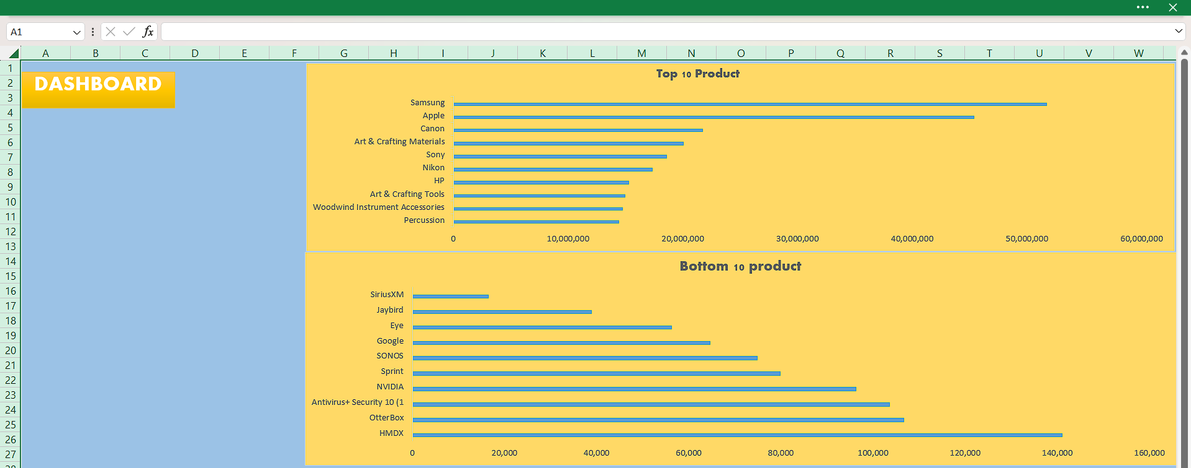
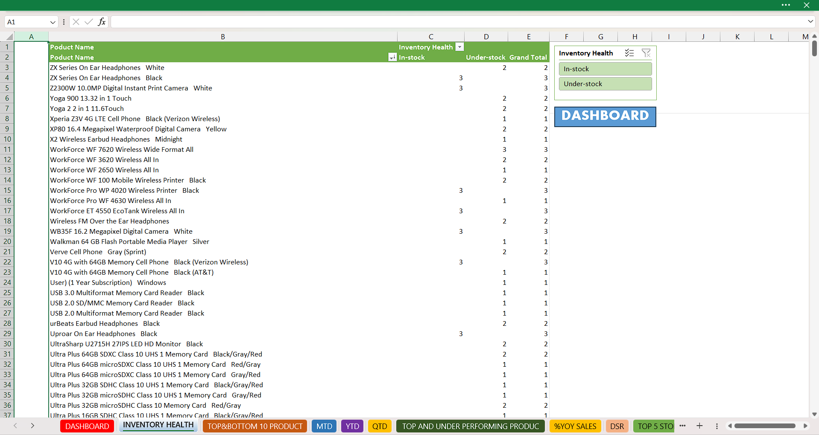

Slide 8
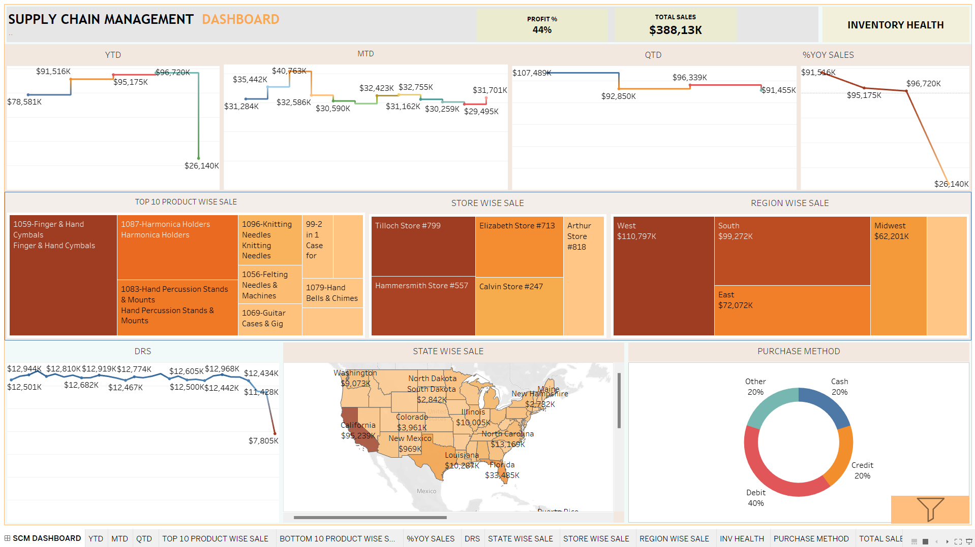
TABLEAU DASHBOARD
NAVIGATION BUTTON
SHOW FILTER &HIDE FILTER OPTION

Slide 9
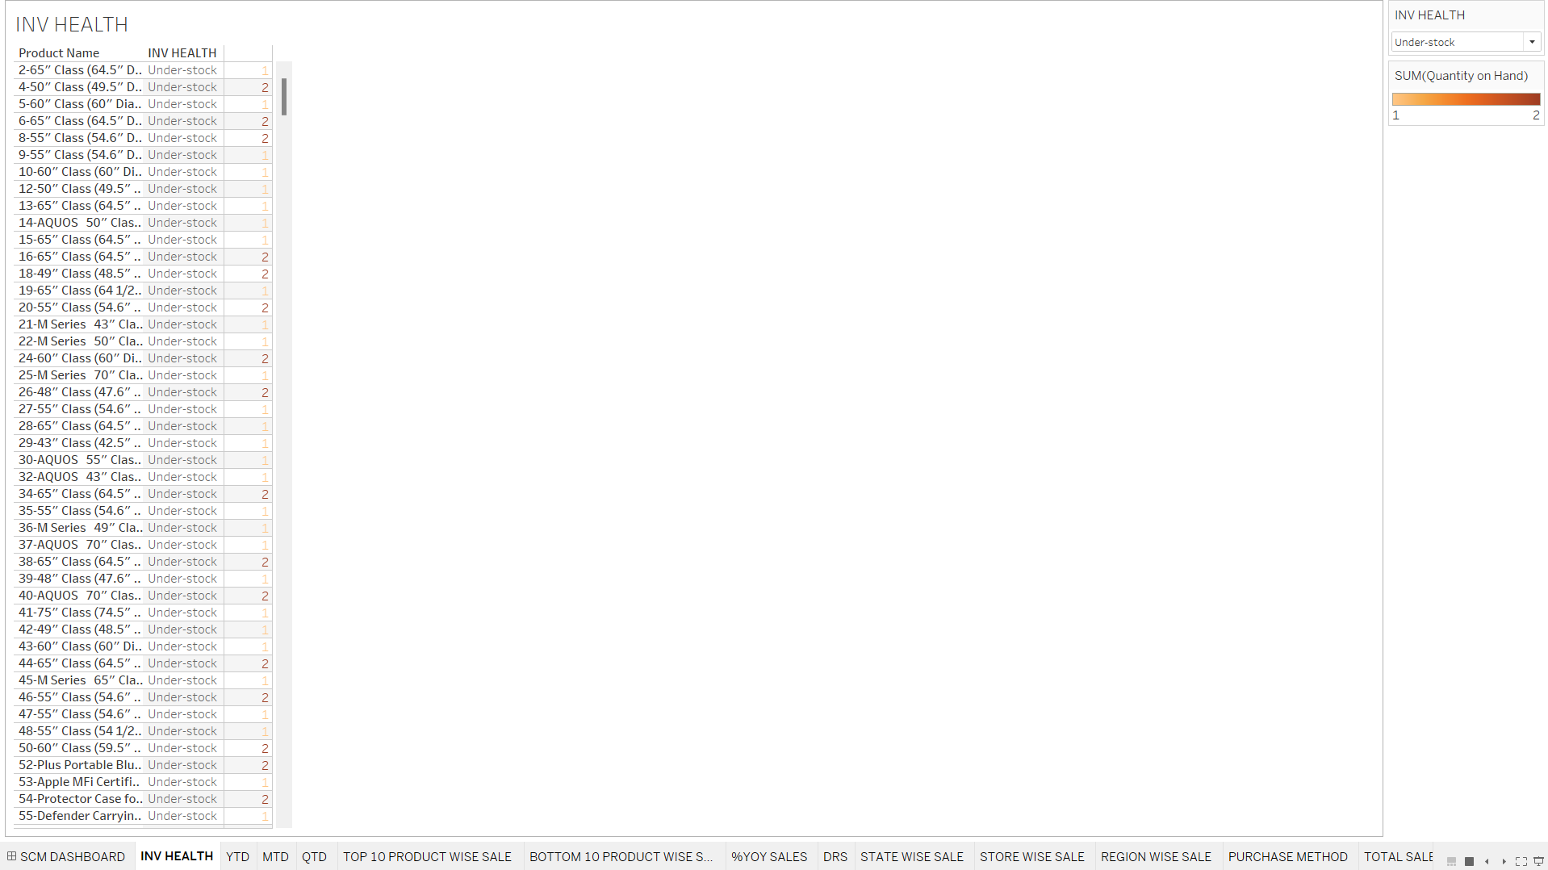

Slide 10
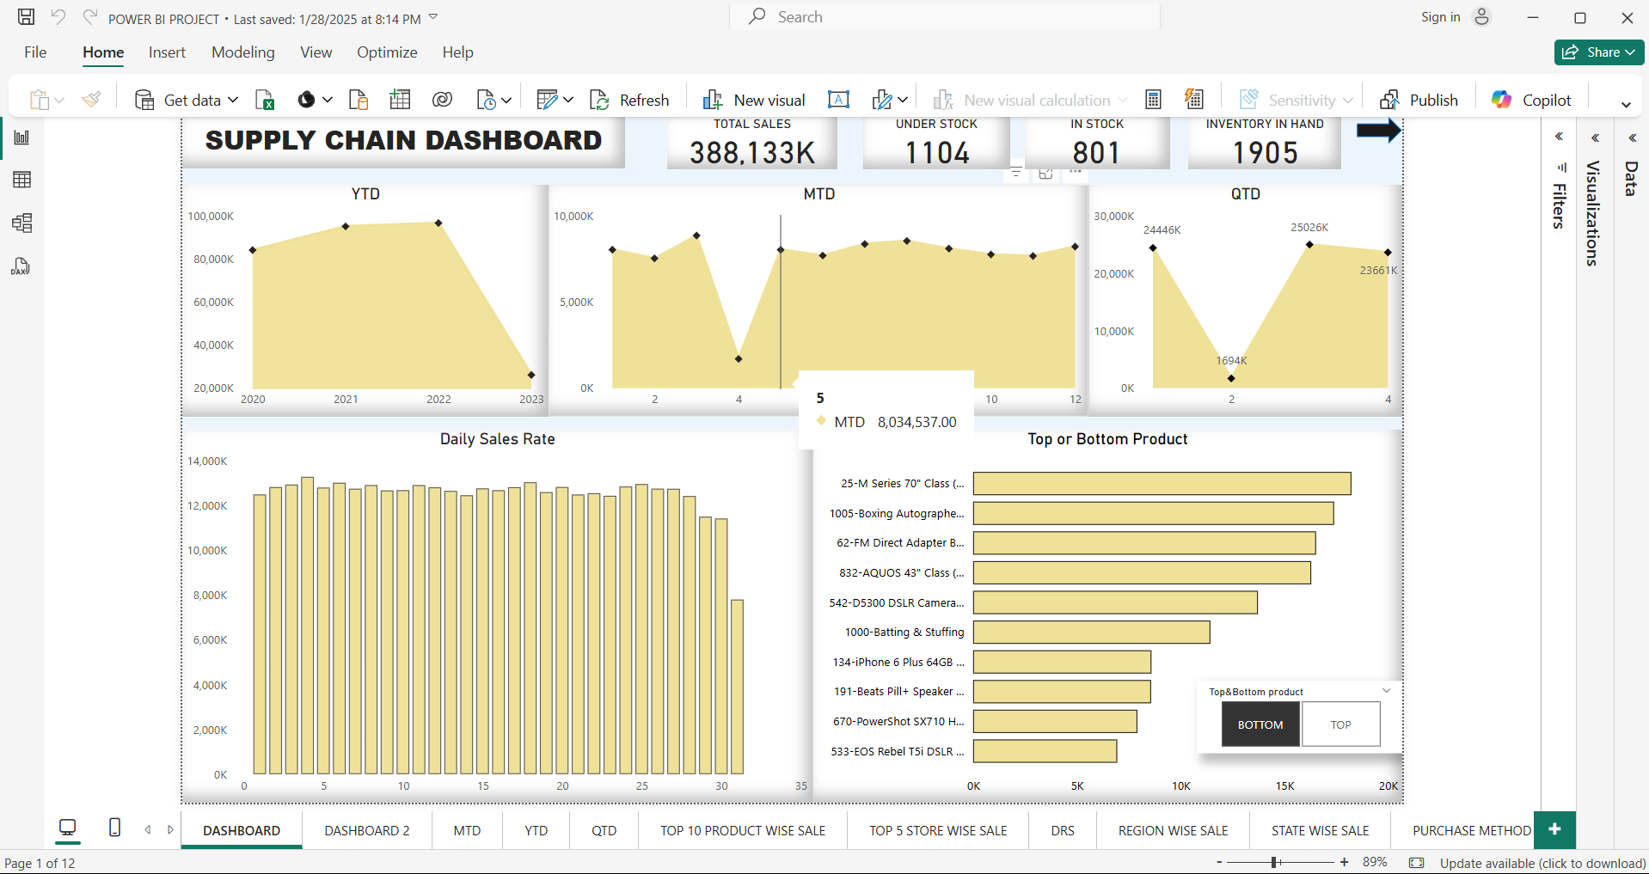
POWER BI DASHBOARD

Slide 11
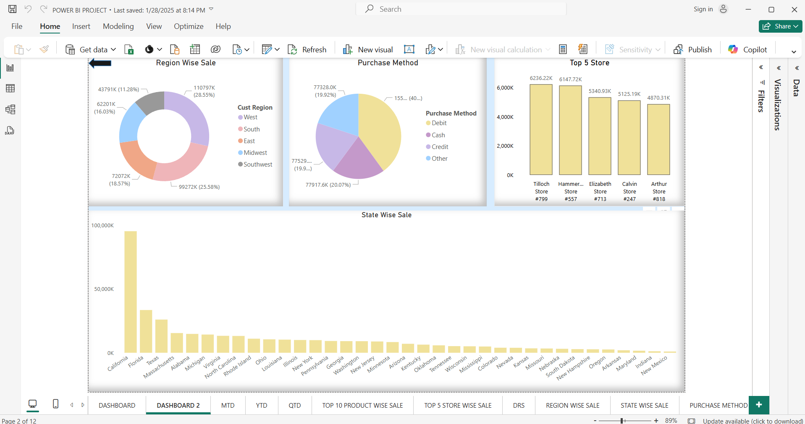

Slide 12
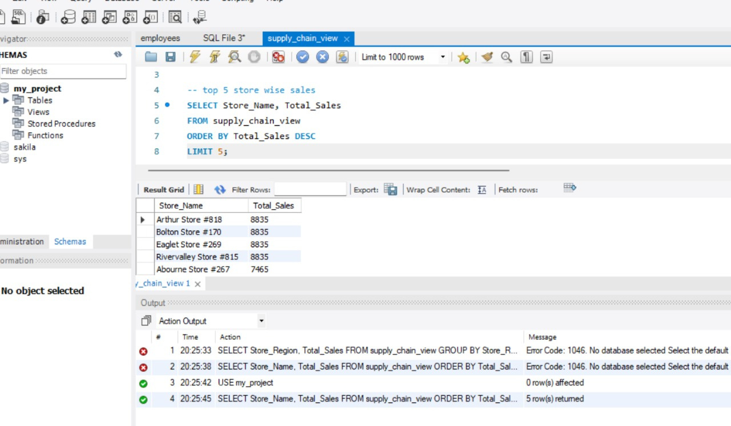
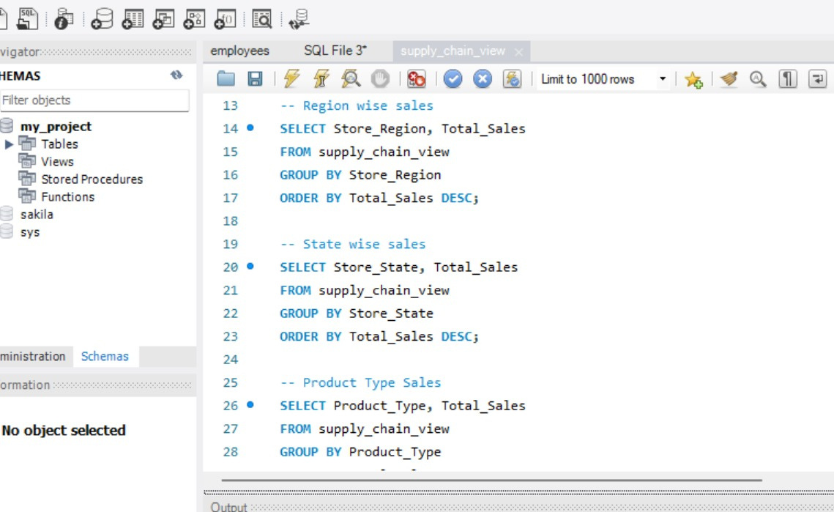
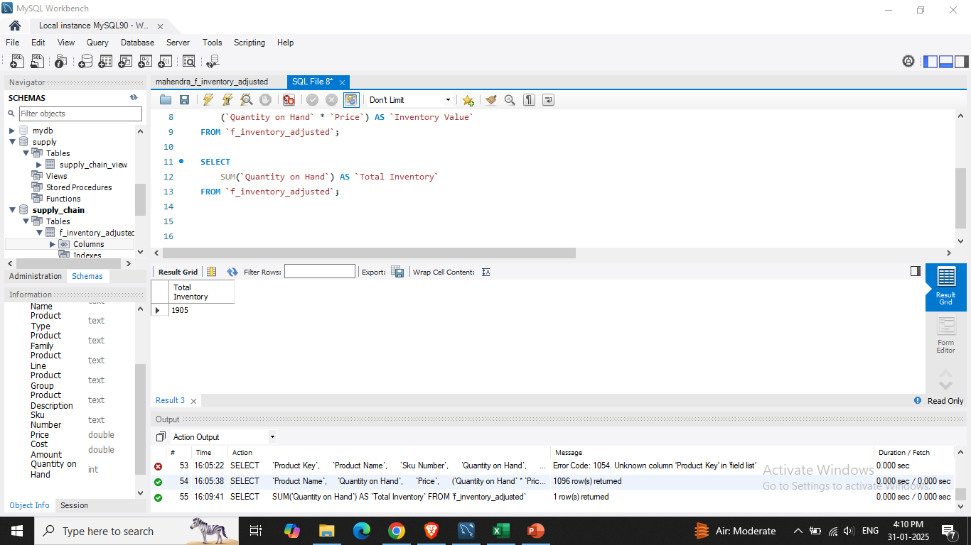
SQL QUERY

Slide 13
KEY TAKEAWAY
Optimized Inventory Management: Improved stock control through data-driven insights, reducing stockouts and overstocking.
Enhanced Decision-Making: SQL queries and dashboards provided real-time visibility into inventory trends, demand forecasting, and supplier performance.
Cost Reduction & Efficiency: Streamlined supply chain operations by minimizing holding costs, improving order fulfillment rates, and ensuring better resource allocation.

Slide 14
THANK
YOU

